Slide 1



Introduction to Quantum Cryptography with a hands-on polarization laser lab
Today’s Agenda:
Introduction to light as an electromagnetic wave & polarization
Introductory polarization lab
Quantum Measurements using polarization
Introduction to Quantum Cryptography
Quantum Cryptography lab with polarization filters and lasers
Donn Silberman
Mentor

Slide 2
Light is an Electromagnetic Wave
Amplitude → Size of each vibration
Direction → Path of each vibration
Length → Separation between vibrations
Scientists study the properties of things.
Properties of waves include:
Amplitude, Direction, Length

Slide 3
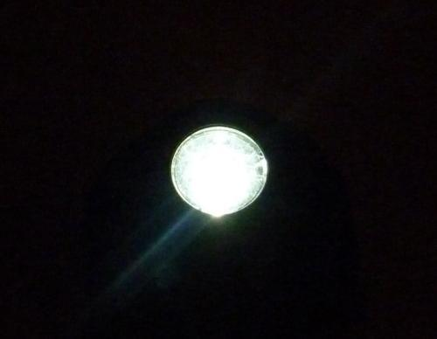
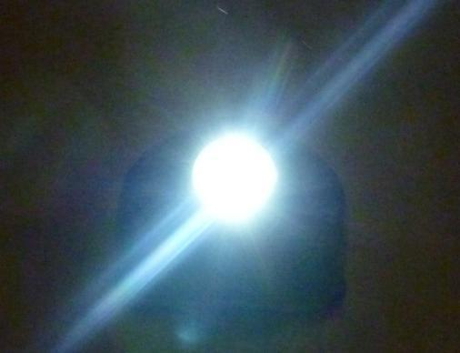
Light is an Electromagnetic Wave
Amplitude → Size of each vibration → Power
Direction → Path of each vibration
Length → Separation between vibrations
dim light
small vibrations
Bright Light
LARGE VIBRATIONS
Images courtesy Brian Monacelli

Slide 4
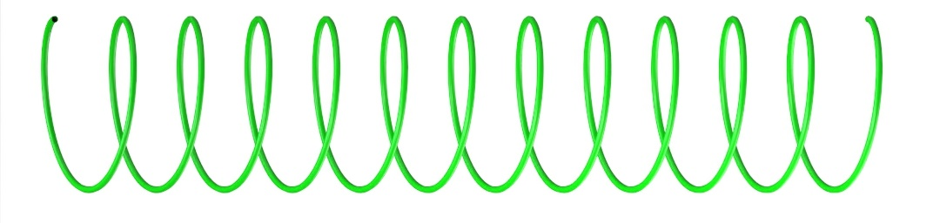
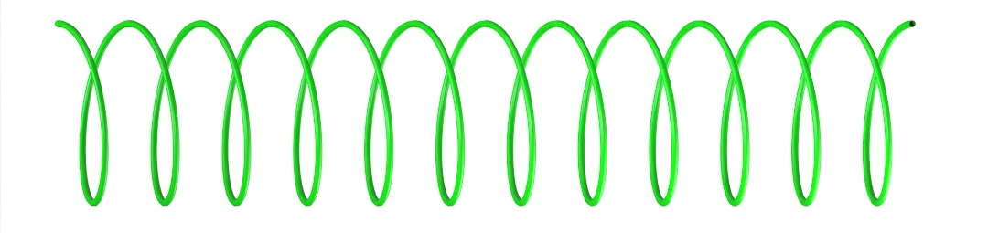
Light is an Electromagnetic Wave
Amplitude → Size of each vibration → Power
Direction → Path of each vibration → Polarization
Length → Separation between vibrations
Vertical Linear Polarization
Horizontal Linear Polarization
Left Circular Polarization
Right Circular Polarization
Figure courtesy Brian Monacelli

Slide 5
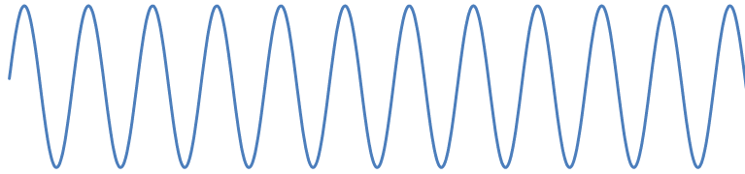
Unpolarized (or Randomly Polarized) Light
unpolarized light
surface normal
θ_{i}
optical surface
Figure courtesy Brian Monacelli

Slide 6
Linear p-polarized Light
p-polarized light
surface normal
θ_{i}
optical surface
Figure courtesy Brian Monacelli

Slide 7
Linear s-polarized Light
s-polarized light
surface normal
θ_{i}
optical surface
Figure courtesy Brian Monacelli

Slide 8
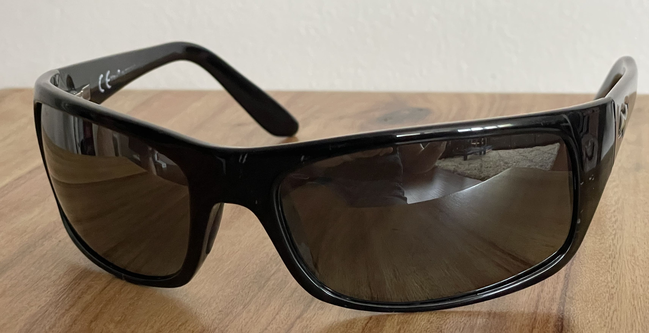
Linear Polarizers
transmission axis
unpolarized light
linearly polarized light
Figure courtesy Brian Monacelli
Image courtesy Erin Monacelli

Slide 9
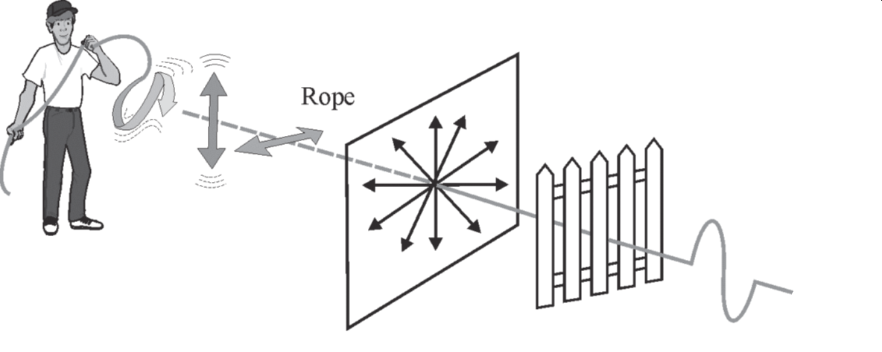
Polarization Analogy
An unpolarized rope waves through a picket fence
On the other side of the picket fence, the rope’s motion is polarized along the slats
This figure by LASER-TEC is licensed CC BY-NC-SA.

Slide 10
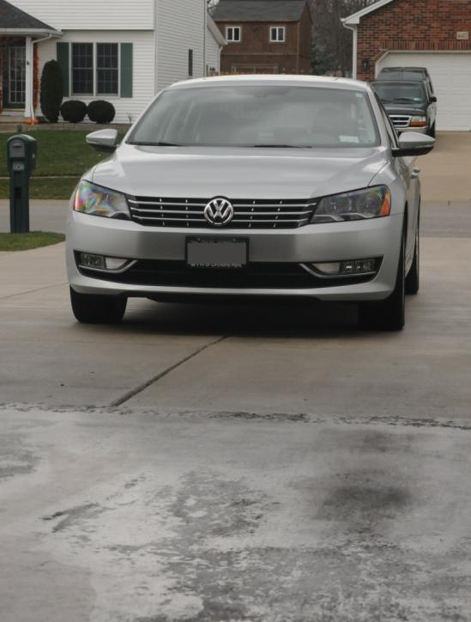
Polarized Sunglasses Block Glare
without polarized sunglasses
Watch the car windshields and hood
Image courtesy Brian Monacelli
Polarizers block horizontally s-polarized light, and transmit vertically p-polarized light

Slide 11
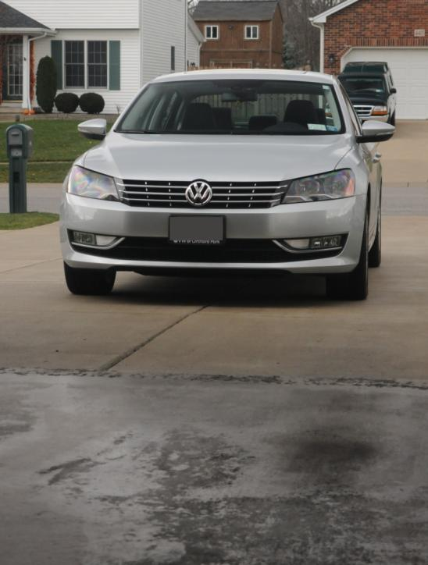
Polarized Sunglasses Block Glare
with polarized sunglasses
Watch the car windshields and hood
Image courtesy Brian Monacelli
Light reflecting off the ground is horizontally s-polarized

Slide 12
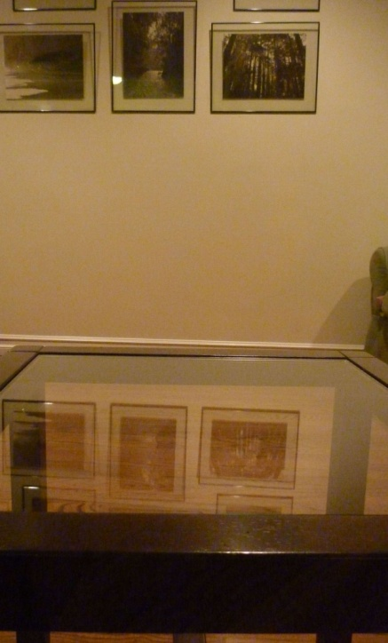
Polarized Sunglasses Block Glare
without polarized sunglasses
Watch the reflected images of the
pictures on the wall in the glass tabletop.
Image courtesy Brian Monacelli
Polarizers block horizontally s-polarized light, and transmit vertically p-polarized light

Slide 13
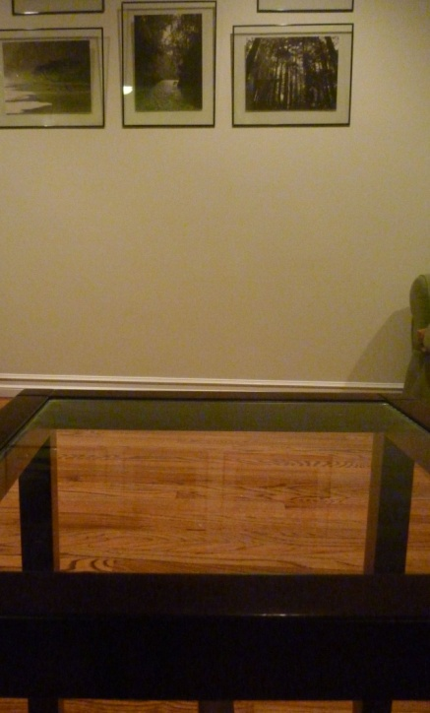
Polarized Sunglasses Block Glare
with polarized sunglasses
Watch the reflected images of the
pictures on the wall in the glass tabletop.
Image courtesy Brian Monacelli
Light reflecting off the glass is horizontally s-polarized

Slide 14
Polarized Sunglasses Block Glare
Tac Visor commercial
  https://youtu.be/NCCR2a5Szb8
And now for an experiment you can do here.
  https://youtu.be/HoHNI-Sr-t8

Slide 15
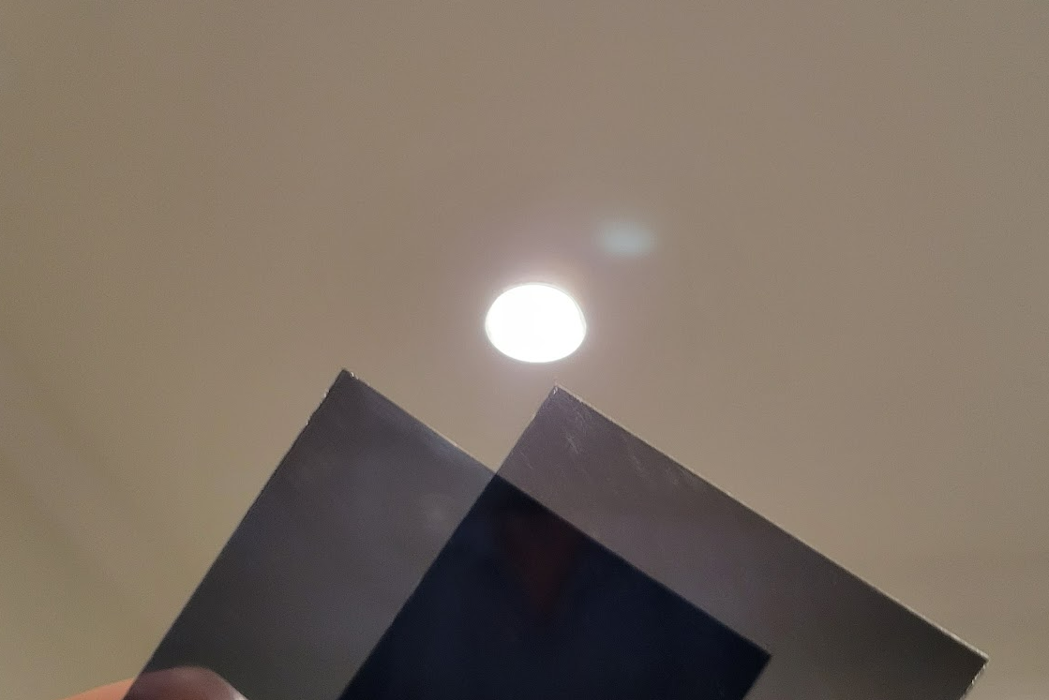
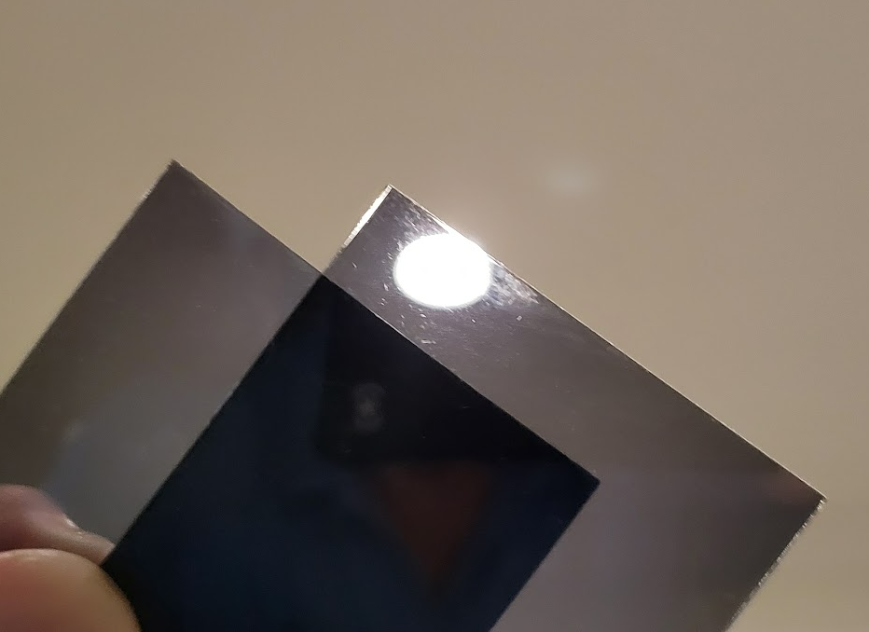
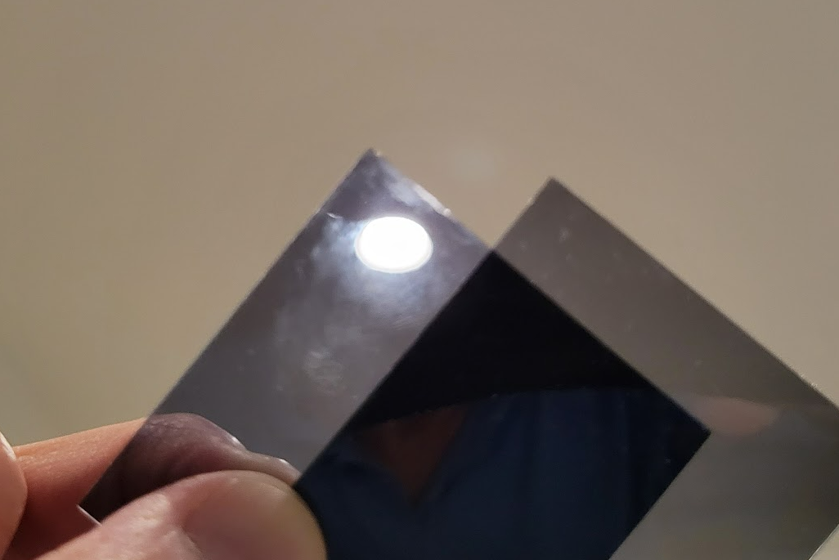
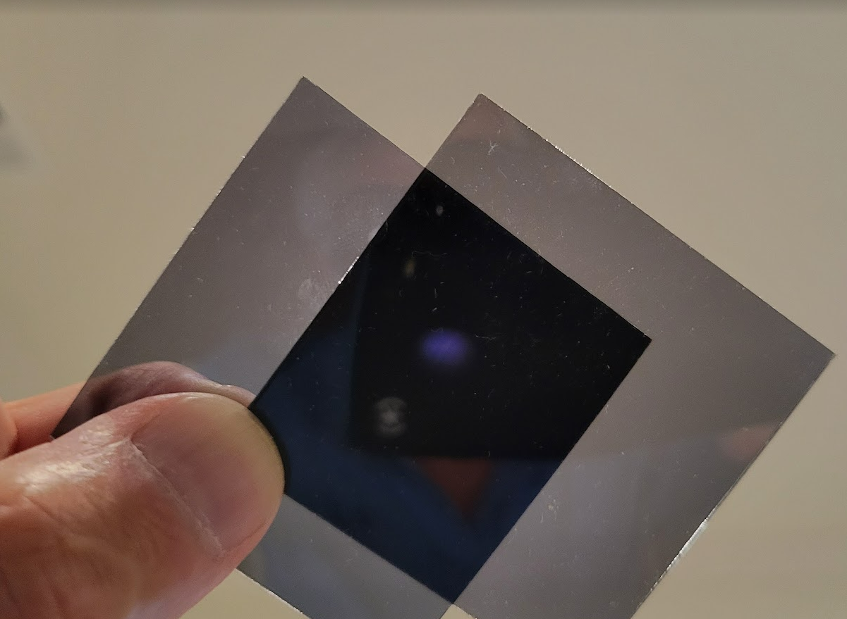
Polarization Filters – Hands-on Experiment
Ceiling light – no P filters
Ceiling light – one P(h) filter
Ceiling light – one P(v) filter
Ceiling light – both P(h & v) filters
Page 1 of 2

Slide 16

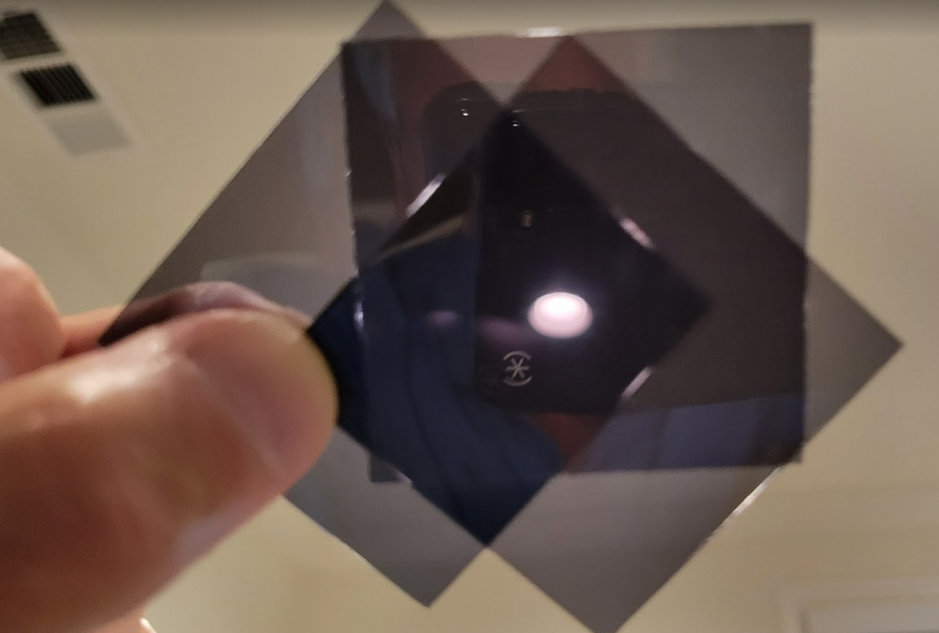
Polarization Filters
Ceiling light – both P(h & v) filters
Ceiling light – both P(h & v) filters
Plus a third P filter at 45 deg !!!
(sandwiched in-between)
How does the filter in between let more light pass through??
This is the science of light !!! Polarized light is incorporated into many consumer electronic devices; like your cell phone display and computer monitor.
Look through one, two and three filters at your computer monitor and start rotating them !!! Very Interesting.
Page 2 of 2

Slide 17
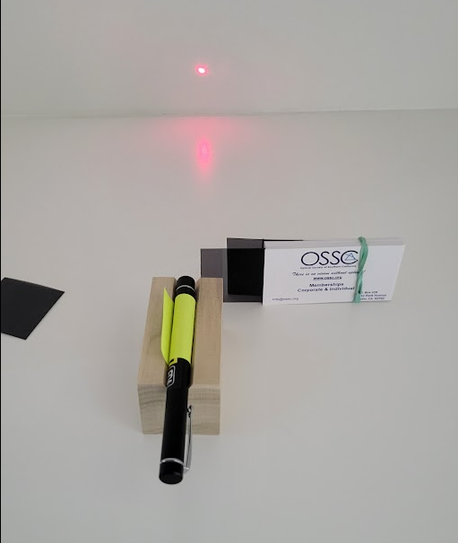
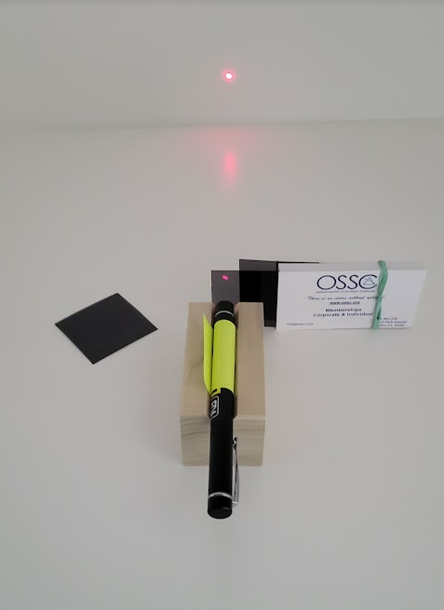
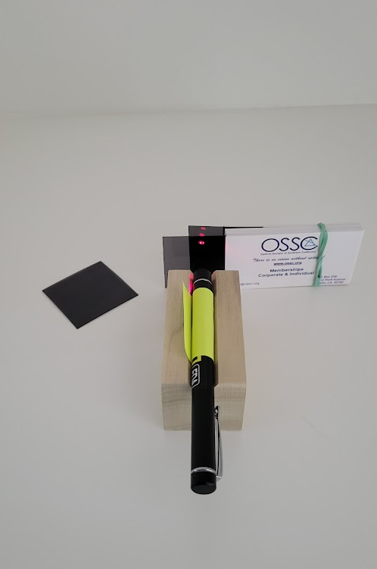
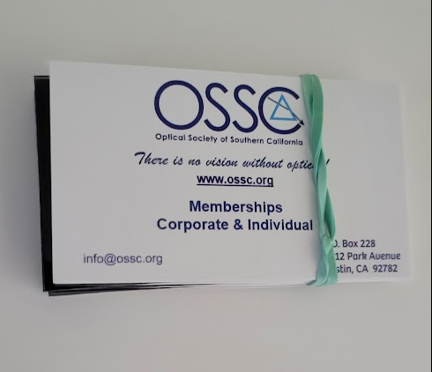
Polarization Filters with a Polarized Laser
Laser with no P filter
Laser with P(h) filter
Laser with P(h+v) filters

Slide 18
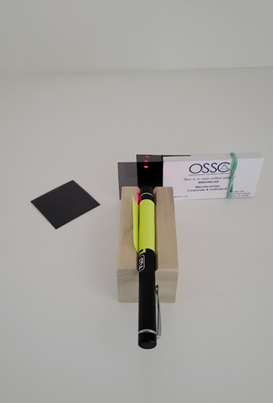
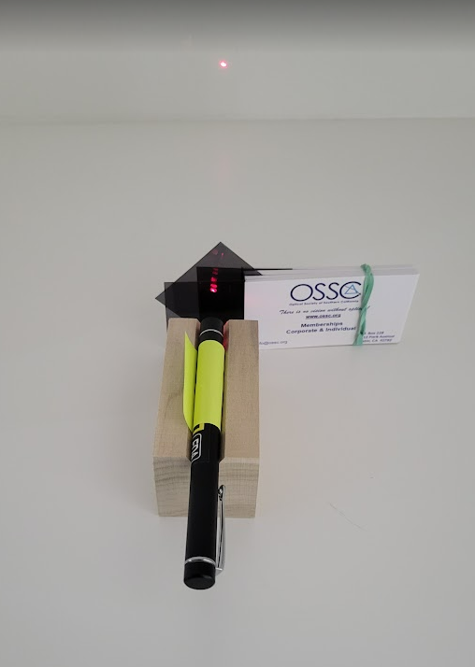
Polarization Filters with a Polarized Laser
Laser with P(h+v) filters
Laser with P(h+ v + 45) filters

Slide 19
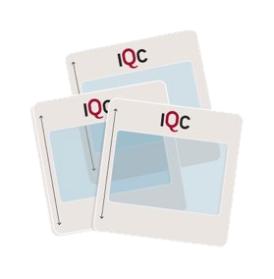
THE TWO GOLDEN RULES OF QUANTUM MECHANICS
SESSION #1

Slide 20

Learning Objectives
The role of probabilities in quantum mechanics
  Outcomes are not necessarily definite
The nature of quantum superposition
  Superposition as a relative concept
Measurement disturbance
  We can’t make two incompatible measurements at once
We can apply these ideas to build technologies
  Quantum cryptography is based on quantum measurement

Slide 21
Prerequisite Knowledge
Light is a wave with a polarization
  Crossed polarizers should be familiar
Light is emitted in units called photons
  Previous encounter with the photoelectric effect
The Cartesian plane and vector components
  If advanced, can be taught using formal linear algebra
  Otherwise, perfectly possible to avoid

Slide 22


Opening Question
What is a quantum measurement?

Slide 23

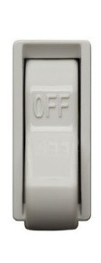
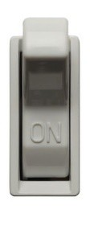
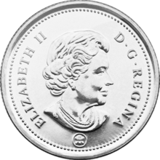
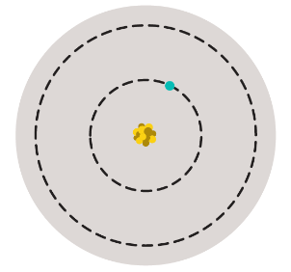
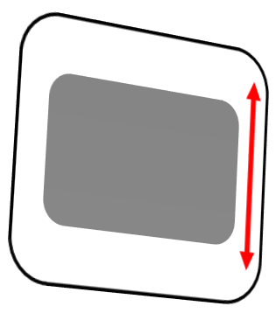
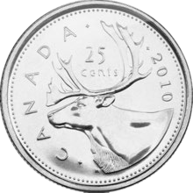








Mutually Exclusive States
A quantum measurement distinguishes between two or more mutually exclusive states.
Classical Examples
Quantum Examples
Two states are mutually exclusive
if being found in one state means it definitely isn’t in the other.
_{e}-
The measurement tells us which of the two states our object was in.

Slide 24

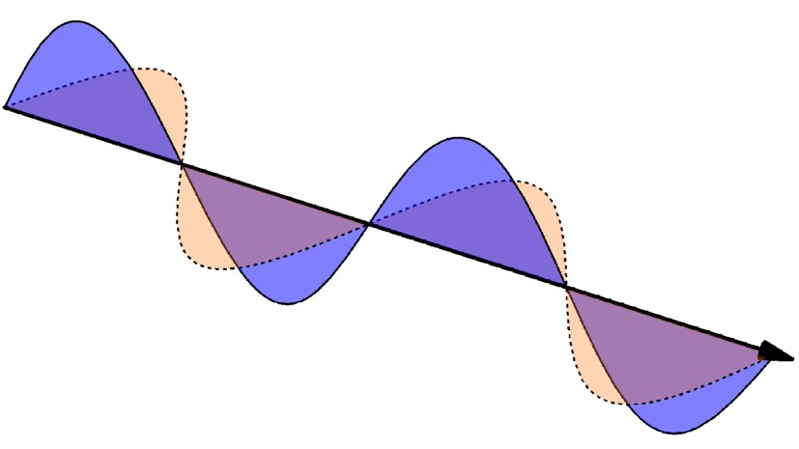


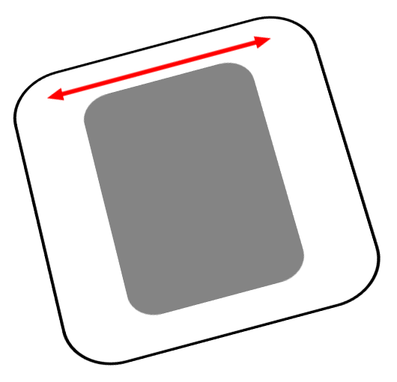
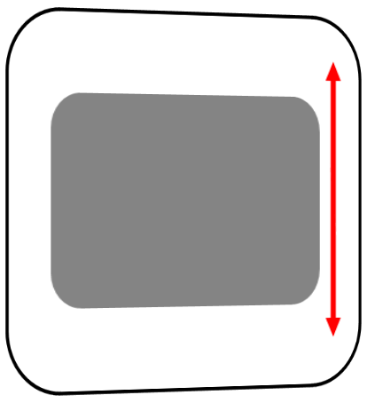
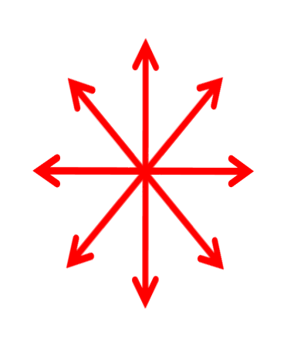





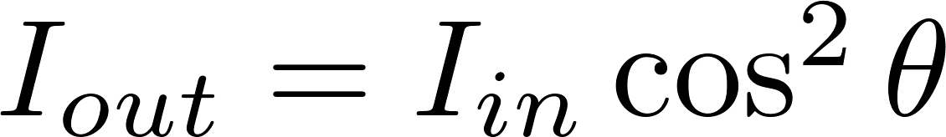







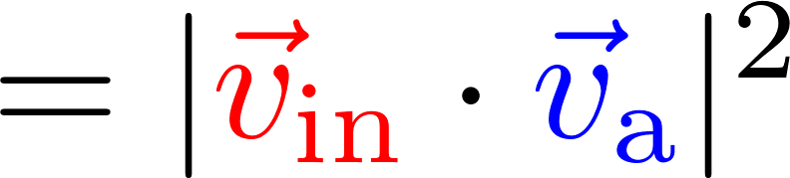
Polarization of Light: Wave Picture
Polarizers
Malus’ Law
The intensity of light that makes it through the analyzer depends on the angle between the analyzer and the light’s polarization.

Slide 25
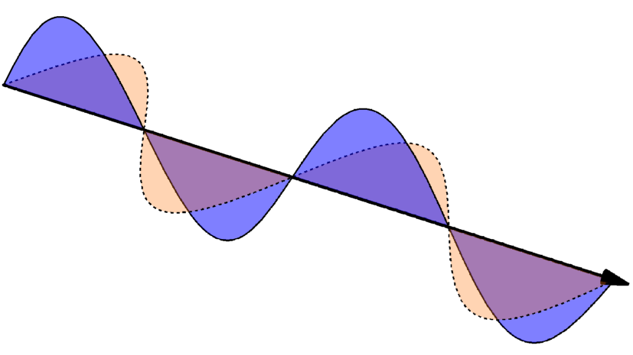
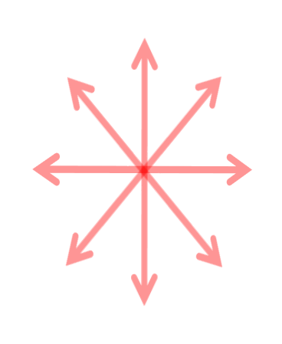
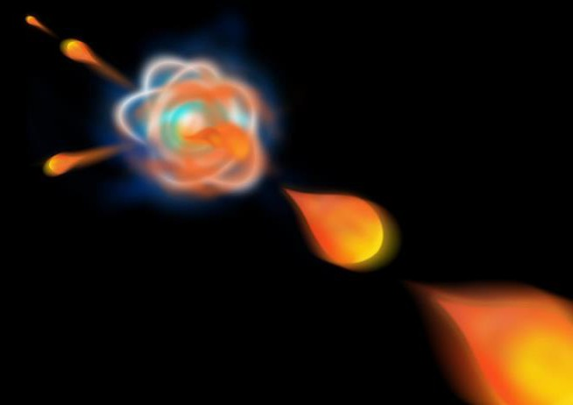


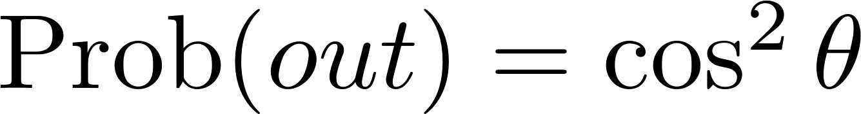
Polarization of Light: Photon Picture
One vertically polarized
photon
Two possibilities:
The photon passes through the analyzer
The photon is absorbed
Light is made up of photons.
What happens to a single photon of light at a polarizer?
We must consider the probability
of each event occurring

Slide 26

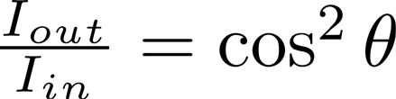




Malus’ Law with Photons
A horizontally polarized single photon is incident on a polarizer at angle θ. What are the probabilities of it being absorbed or transmitted?
 | Θ = 0° | 45° | −45° | −30° | 60° | 90°
^{𝐼}𝑜 ^{/𝐼}𝑖 | 1 | 1 2 | 1 2 | 3 4 | 1 4 | 0
Probability transmitted | 1 | 1 2 | 1 2 | 3 4 | 1 4 | 0
Probability being absorbed | 0 | 1 2 | 1 2 | 1 4 | 3 4 | 1
Wave picture
Photon picture
Mathematically, no difference between wave and photon picture.
But the interpretation differs greatly.

Slide 27


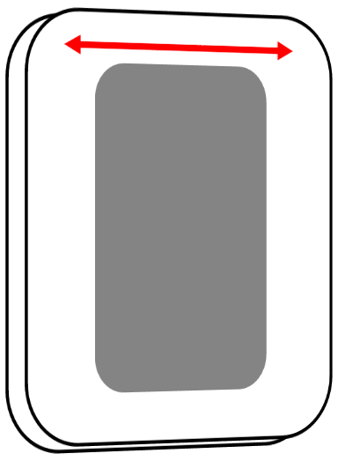
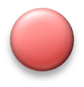

Breakout Session
Which polarization states are mutually exclusive?
If a photon makes it through a horizontal polarizer, what can we conclude about its polarization state before and after the polarizer?

Slide 28
Polarization Measurements
The polarizer asks the photons a question, such as:
Are you horizontally or vertically polarized?
Are you
+45° or -45°
polarized?
Are you
+30° or -60°
polarized?
A pair of mutually exclusive quantum states is called a measurement basis

Slide 29
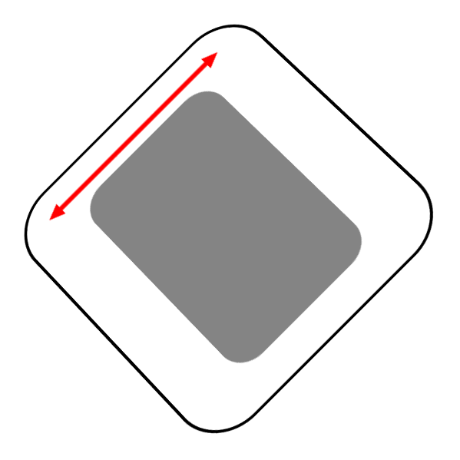
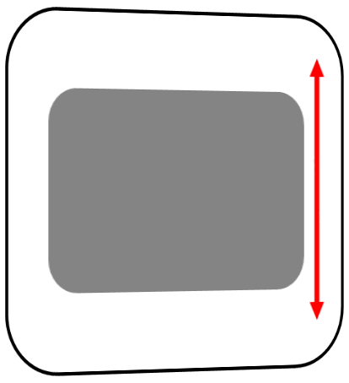
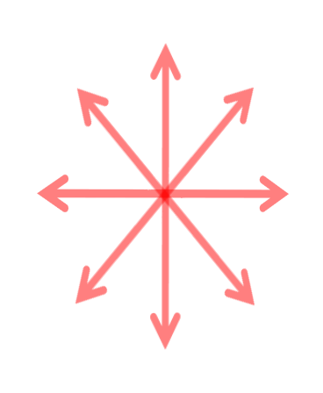

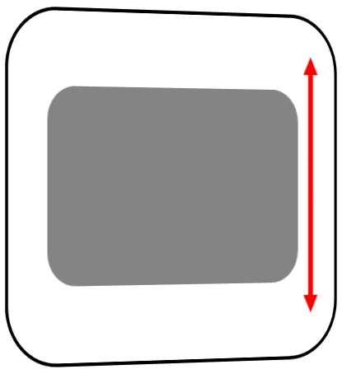



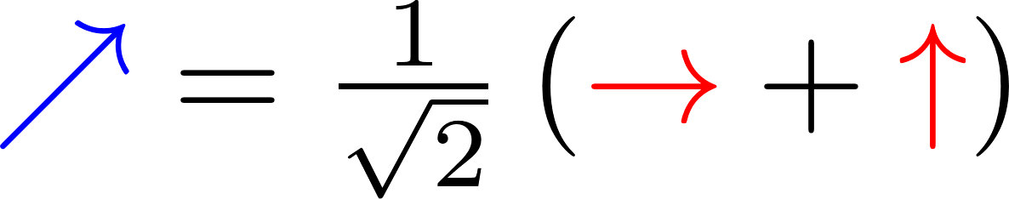
Asking questions with polarizers
If it transmits, it is now vertically polarized
To solve, we need to describe it in the HV basis
Intuitively, can think about as vector addition
50%
Probability Transmitted
50%
Probability Absorbed

Slide 30
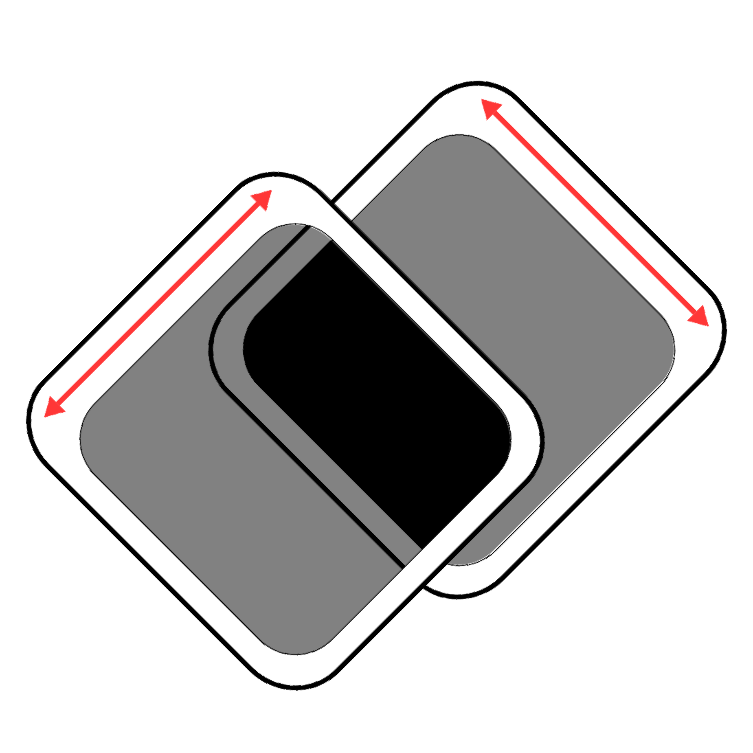
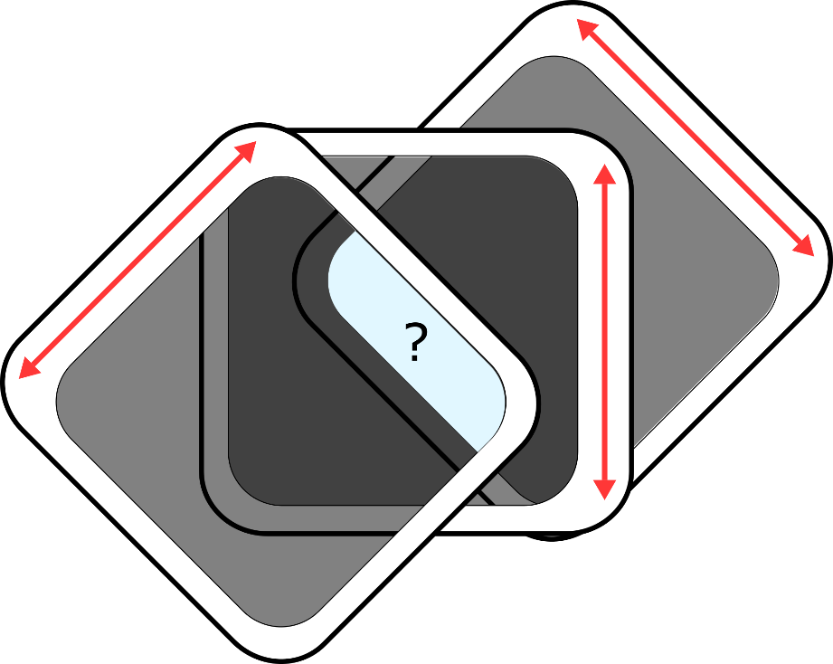
Polarization beyond Malus’ Law
-45°
-45°
90°
+45°
+45°
Two crossed polarizers No light passes through
Three polarizers
???

Slide 31
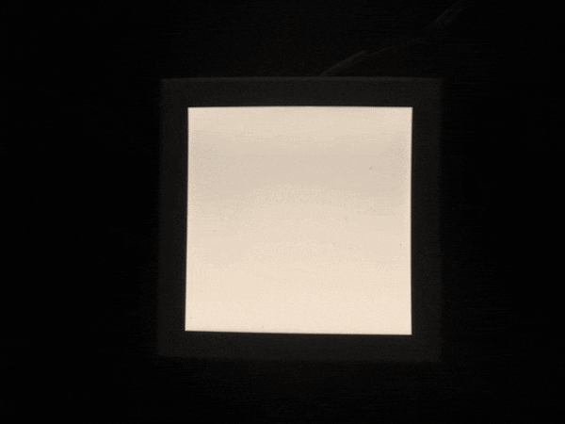
Polarization beyond Malus’ Law
-45°
-45°
90°
+45°
+45°
Two crossed polarizers No light passes through
Three polarizers
???

Slide 32





Superposition and Measurement
One
+45°-polarized photon

Slide 33



If it transmits, it’s definitely vertical now
Superposition and Measurement
Transmits with 50% probability

Slide 34





Superposition and Measurement
Transmits again with 50% probability
The photon has a 25% chance of making it through Measurement changes the state!

Slide 35












The Two Golden Rules
Rule #1 Superposition
A photon can behave as if it is both
“here” and “there”
Rule #2 Measurement uncertainty
When asked where it is, the photon will be found either
“here” or “there”
Wave behaviour
Particle behaviour

Slide 36










Which of the following states is a superposition state?
A.
C.
B.
D.
Horizontal polarization
Vertical polarization
+45° diagonal polarization
None are superposition states
E.
All could be superposition states

Slide 37








The Two Golden Rules of Quantum Mechanics
Measurement Basis
Defines which “question” I ask the particle
The particle is both “→” AND “↑”
at the same time
The particle is both “↗” AND “↘”
at the same time
Superposition
Always relative to the basis in which we are measuring
BUT
BUT
When measured in the → /↑ basis, it will be found as
“→” OR “↑”
randomly
When measured in the ↗ /↘ basis, it will be found as
“↗” OR “↘”
randomly

Slide 38









Summary
Superposition is a relative concept, depending on the
measurement basis being used
The act of measurement changes the state
Most quantum measurements are incompatible

Slide 39








Polarization and Spin
The three-polarizer experiment is mathematically equivalent to the Stern-Gerlach experiment
Spin-Polarized Electrons
Polarized Photons
Check out the simulation on QuVis! www.st-andrews.ac.uk/physics/quvis/ “Measurement Uncertainty” Demo

Slide 40

Question Break

Slide 41



Break Time

Slide 42






QUANTUM CRYPTOGRAPHY

Slide 43








The Science of Secrets
Cryptography

Slide 44



Keys and Security
Alice
Bob
Secure channel
Alice and Bob use a secure channel to share
identical copies of a key

Slide 45



Keys and Security
Alice
Bob
Secure channel
An eavesdropper can see the safe, but can’t open it without the key
Public channel

Slide 46




Keys
In real life, the key is information
Alice and Bob have the information, but the eavesdropper doesn’t
Door Lock
Key: Which pins to press
Secret Code
Key: Translation back to English
Safe
Key: The PIN Number
Door Lock
Key: ???
Secret Code
Key: ???

Slide 47





The Caesar Cipher
A | B | C | D | E | F | G | H | I | J | K | L | M | N | O | P | Q | R | S | T | U | V | W | X | Y | Z
G | H | I | J | K | L | M | N | O | P | Q | R | S | T | U | V | W | X | Y | Z | A | B | C | D | E | F
HELLO
Encrypt
NKRRU
Decrypt
HELLO
= 6 letter shift
= NKRRU ciphertext
Big Problem!
If you know one encrypted letter, you know the whole message!

Slide 48





The One-Time Pad (aka Vernam cipher)
A | B | C | D | E | F | G | H | I | J | K | L |  | M | N | O | P | Q | R | S | T | U | V | W | X | Y | Z
L | M | N | O | P | Q | R | S | T | U | V | W |  | X | Y | Z | A | B | C | D | E | F | G | H | I | J | K
Q | R | S | T | U | V | W | X | Y | Z | A | B |  | C | D | E | F | G | H | I | J | K | L | M | N | O | P
M | N | O | P | Q | R | S | T | U | V | W | X |  | Y | Z | A | B | C | D | E | F | G | H | I | J | K | L
D | E | F | G | H | I | J | K | L | M | N | O |  | P | Q | R | S | T | U | V | W | X | Y | Z | A | B | C
U | V | W | X | Y | Z | A | B | C | D | E | F |  | G | H | I | J | K | L | M | N | O | P | Q | R | S | T
A different Caesar cipher for each letter
HELLO
Encrypt
SUXOI
Decrypt
HELLO
= 5 random shifts
= SUXOI ciphertext

Slide 49


The One-Time Pad
Message | 01101000
Key | 01001001
Cipher | 00100001
Cipher | 00100001
Key | 01001001
Message | 01101000
Key Bit
Alice and Bob share a long random binary string
 | 0 | 1
0 | 0 | 1
1 | 1 | 0
Message Bit
Encode and decode by adding mod-2 (XOR)

Slide 50
The One-Time Pad
Message | 01101000
Key | 01001001
Cipher | 00100001
Cipher | 00100001
Key | 01001001
Message | 01101000
8-bit key
2⁸ possible keys
Number of possible keys = Number of possible messages
Perfectly secure!
But we’re forgetting something…

Slide 51


One-Time Pad Big-Time Problem
Alice
Bob
EVE
How do Alice and Bob securely share the key in the first place?

Slide 52




Quantum Key Distribution
Alice and Bob generate the key by sending polarization-encoded photons to each other

Slide 53
















Quantum Key Distribution
Remember the three polarizers?
EVE
If the eavesdropper intercepts, they’ll disturb the polarization state

Slide 54











The Heart of QKD
Measurement Disturbance
The No-Cloning Theorem
When we measure a quantum state, we disturb it

Slide 55













Polarization Qubits
 | H/V measurement | A/D measurement
 | H for sure | random ?
 | ? V for sure | random
 | random ? | D for sure ?
 | random | A for sure
Encode binary “0” or “1” as a polarization state, with two possible bases

Slide 56

Question Break

Slide 57

Quantum Key Distribution (QKD)
QKD uses single-photon signals to establish a secure secret key
Eavesdroppers are detected due to
measurement disturbance
Many protocols exist, including some using entanglement
The most well-known is the Bennett-Brassard (BB84) protocol
Charles Bennett (left), IBM Research Giles Brassard (right), Université de Montréal

Slide 58











The BB84 Protocol
Step 7
Repeat and repeat until a long, random binary string is built
Step 4
Bob randomly chooses a measurement basis
Step 1 Alice chooses
“0” or “1” randomly
Step 2 Alice chooses the
H/V or ±45° basis randomly
Step 8
Estimate the error rate in the string
Step 5
Bob records the result of his measurement
“0” “1”
“±45°”
“0”
Step 3
Alice encodes the appropriate qubit and sends it to Bob as a single photon
“0”
“±45°”
Step 6
Alice and Bob publicly announce which bases they used, keeping their bit values secret
Alice’s Lab
I used the ±45°
basis
I used the ±45°
basis
Bob’s Lab

Slide 59






































BB84 Example
0 1 1 1 0 0 1 0 1
1. Alice chooses a RANDOM bit
Alice chooses a RANDOM basis
Alice send the state to Bob
4. Bob measures in a RANDOM basis
R R R R
0 R 1 1 R 0 1 R R
5. Bob records the bit
6. Alice and Bob announce the basis

Slide 60
































BB84 Example
0 1 1
1 0 0 1 0 1
Basis Reconciliation Alice and Bob discard all bits where their bases didn’t match
This leaves them with the secret key
01101
R
0 R 1
R R R
1 R 0 1 R R
What if there’s an eavesdropper?

Slide 61

























































0 1 1 1 0 0 1 0 1
R R R R
R 1 R 0 R R 1
0 1
R R R R R R
0 R R 1 R 0 R R R

Slide 62
Breakout Session
What is the probability that Eve introduces an error for one photon?
What is probability that Eve does NOT introduce an error within 100 photons?
Why did Alice and Bob need to choose their bases randomly?

Slide 63

Error Estimation & Correction
The presence of Eve unavoidably introduces errors into Alice and Bob’s key
By sacrificing some bits to estimate the error, Alice and Bob can either:
Detect the presence of the eavesdropper
OR
Guarantee that no eavesdropper was present

Slide 64


Error Estimation and Correction
Parity Check
See if addition of neighbouring bits matches over the whole string
1 | 0 | 0 | 1 | 1 | 0 | 1 | 0 | 0 | 1 | 0 | 1
“Raw” Key
“Raw” Key
1 | 0 | 0 | 1 | 1 | 0 | 1 | 1 | 0 | 1 | 0 | 1
1 | 0 | 1 | 0
🗸 | 🗸 | 🗴 | 🗸
Communicate Publicly
1 | 0 | 0 | 0
🗸 | 🗸 | 🗴 | 🗸
Discard sets with errors &
One bit from each correct set
to maintain secrecy
🗴 | 0 | 0 | 🗴 | 1 | 0 | 🗴 | 🗴 | 🗴 | 🗴 | 0 | 1
🗴 | 0 | 0 | 🗴 | 1 | 0 | 🗴 | 🗴 | 🗴 | 🗴 | 0 | 1
0 | 0 | 1 | 0 | 0 | 1
0 | 0 | 1 | 0 | 0 | 1
Final Key
Final Key

Slide 65
QKD Common Misconceptions
We’re not sending a message, we’re sharing a key
  The randomness is good!
  No sensitive information is sent until the key is set
  If Alice chooses her states non-randomly, Eve can hack
Message
Key Cipher
01101000
01001001
00100001
Announcing the bases gives no information about the key
  They can share that over a public channel

Slide 66
Question Break

Slide 67


Quantum Coins Activity
Instructions on Slack
Group divides into four teams
Alice Sends qubits
Bob Measures qubits
Eve Intercepts qubits
Moderator Enforces quantum rules
Model the photon’s state as a coin in one of two boxes Whenever one is measured, the other is shaken
Possible confusion from one quantum state represented with two objects/boxes

Slide 68

QKD Simulators
Simulator from QuVis (St. Andrew’s University) Uses electron spin rather than polarization

Slide 69






QKD Laser Activity
EDU-QCRY1
$3,547 USD
Homebuilt version w/ 3D-printed models
~$150 USD
Student test groups needed!

Slide 70
Superposition, Measurement, and Quantum Cryptography
Applications & Technology

Slide 71

Hacking QKD
QKD security is guaranteed by the laws of physics!
But compromised by the reality of engineering
“unconditionally secure against any eavesdropper who happened to be deaf.” (G. Brassard, 2006)
The Original QKD Demonstration

Slide 72





Sending Photons over Long Distances
Optical fibre
Free-space / Satellites

Slide 73






Quantum Random-Number Generators
10110010010111011001001110000011111011101010101010110000101111100000000111100000000111101110010
Most computers generate “pseudo” random numbers
  The sequence looks random enough, but is perfectly predictable
Quantum mechanics is truly random
  The sequence is unpredictable, even if we know the quantum states
“0”
Random
50/50 superposition
_{“1”} measurement
outcome
idQuantique QRNG

Slide 74
Summary
Quantum systems can carry information
Measurement in one basis disturbs the other
These ideas can be used for information security

Slide 75
Thanks for joining!
The next session will be tomorrow at 7pm ET on Wave-Particle Duality and Quantum Computing
Lingering questions?
Please ask on the #quantum-questions channel

