Slide 1



Time | Event
3:00PM | Reception & Refreshments
3:15PM | Photonics Engineering Lab tours
4:30PM | OSSC + UCSD SPIE business
5:00PM | Speaker Introduction Scaling Lasers & Photonics Technologies From the Lab to the Quantum Market Tim Day, Chairman & CEO, Monarch Quantum
6:00PM | Q&A Session
6:30PM | Meeting Close
To learn more about, or to join the OSSC, please visit our website at www.ossc.org.

Slide 2
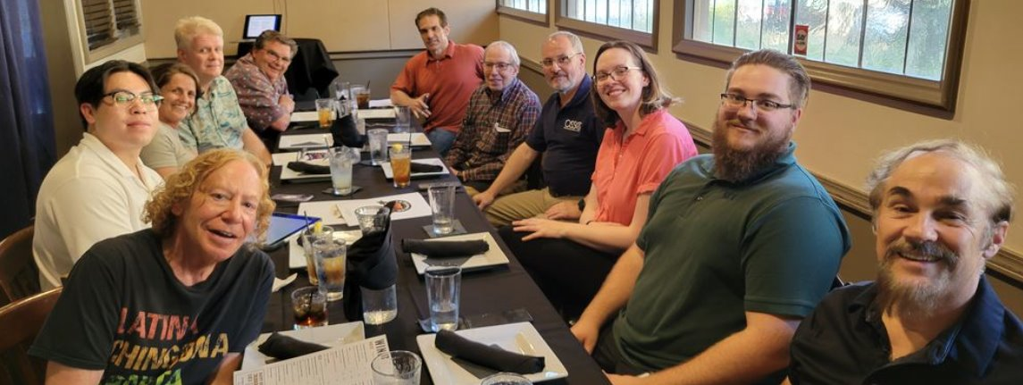
About Us
The Optical Society of Southern California, Inc. (“OSSC”) is a nonprofit 501c(3) tax-exempt organization with a history dating back to 1951. Our mission is to bring together the Optics and Photonics community in Southern California, and we are an official sub-chapter of The Optical Society (“OSA”). We host monthly meetings all around Southern California from October through June that involve networking, dinner service, and a technical presentation. In addition, the OSSC is committed to expanding the awareness of optics through our educational outreach efforts.
To learn more about, or to join the OSSC, please visit our website at www.ossc.org.
The OSSC does NOT endorse candidates for public office or make statements about or contributions to political campaigns or candidates.

Slide 3
Our Purpose
“It is the aim and purpose of this society to increase and disseminate the knowledge of Optics and closely allied sciences, to promote the mutual interest of investigators, teachers and students in these fields, and of designers, manufacturers and users of optical instruments and allied scientific apparatus as well as those who have optics as a hobby, and to encourage cooperation and establish acquaintanceship among these persons.”​
To learn more about, or to join the OSSC, please visit our website at www.ossc.org.
To learn more about, or to join the OSSC, please visit our website at www.ossc.org.

Slide 4
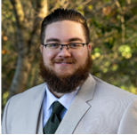
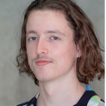
Meet the Board
President
McGwire Herbert
OKSI
Vice President
Stefan Forschner
Impulse Space
Secretary
Sebastian Bresson
Rx Sight Inc.
Treasurer (interim)
Donn Silberman
Quantum Optics Inst.
Immediate Past President
Donn Silberman
Quantum Optics Inst.
Arrangements Chair
Cecily Brown
Bell Collaborative
Programs Chair
Ablimit Albez
Advanced Micro Precision
Membership Chair
Nicholas Croglio
Northrop Grumman
Councilor
SooJin Cha
Sierra Lobo
Councilor
Yryx Luna
Beckman Laser Institute
Councilor
Harvey Spencer
Raytheon
To learn more about, or to join the OSSC, please visit our website at www.ossc.org.

Slide 5
Additional OSSC Volunteers
Communications
Cecily Brown
Mt. Wilson Coordinator
T. Scott Rowe / Cecily Brown
Zoom & Video Coordinator
Ablimit Albez
Corporate Memberships
Mark Gallagher
Newsletter Editor
Yryx Luna
Assistant Secretary
SooJin Cha
Fellows Chair
Harvey Spencer
Outreach Chair
Donn Silberman
Newsletter Assistant
--OPEN--
Historian
T. Scott Rowe
Student Memberships
--OPEN--
Assistant Treasurer
--OPEN--
Jobs Board Coordinator
Nicholas J. Croglio Jr.
Webmaster
Robert Cartland
Assistant Webmaster
--OPEN--
To learn more about, or to join the OSSC, please visit our website at www.ossc.org.

Slide 6
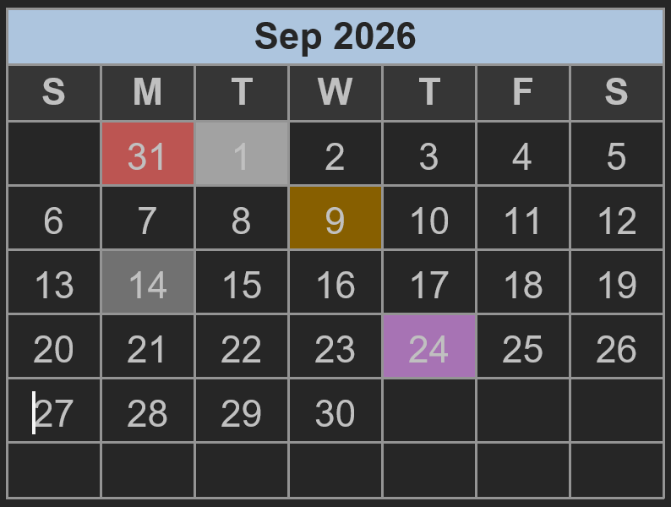
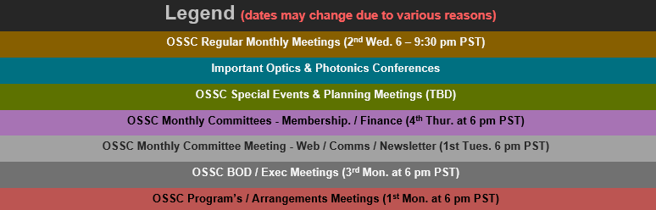
Volunteering with the OSSC
OSSC Committee Meetings for 2025-2026
  Board & Executive Committee – 3rd Monday @ 6 pm
  Programs & Arrangements – 1st or 2nd Monday @ 6 pm
  Communications / Website / Newsletter – Last or 1st Tues. @ 6 pm
  Membership & Finance – 4th Thursday @ 6 pm
  History Project - TBD
  Jobs Board – TBD
  Outreach - TBD
To learn more about, or to join the OSSC, please visit our website at www.ossc.org.

Slide 7
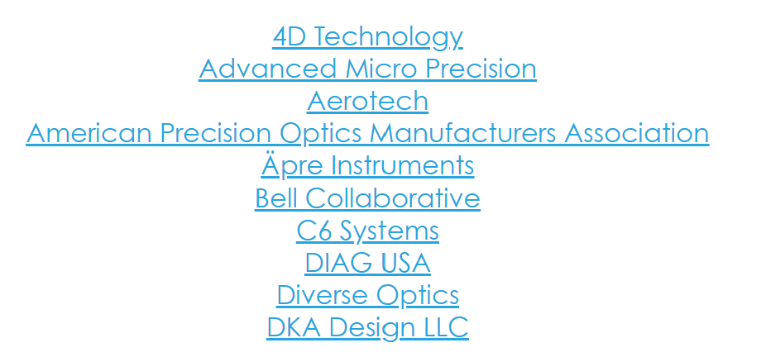
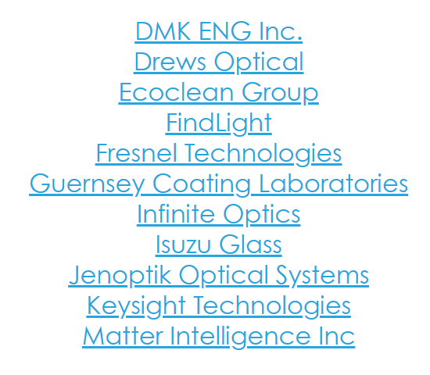
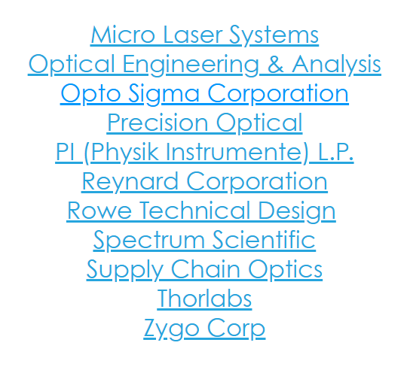
Corporate Members
To learn more about, or to join the OSSC, please visit our website at www.ossc.org.

Slide 8

Website Sponsors
To learn more about, or to join the OSSC, please visit our website at www.ossc.org.

Slide 9










Other Partners
Education
Other Organizations
Government Programs
To learn more about, or to join the OSSC, please visit our website at www.ossc.org.

Slide 10
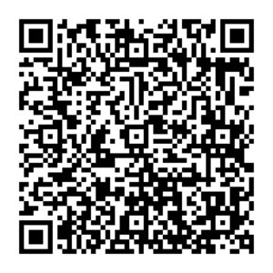
Membership Levels
​Student Membership
Access OSSC resources​
Website Jobs Board​
Website Membership Directory​
Engage with optical industry peers​
Receive various discounts​ with our education
*Student membership includes discounted meals. Student membership reserved for full time students only, contact Nicholas Croglio for information
Individual Member
Access OSSC resources​
Website Jobs Board​
Website Membership Directory​
Engage with optical industry peers​
Receive various discounts​ with our education partners
​Corporate Membership
Promotion on OSSC website​
Promotion on OSSC Social Media
Complementary Corporate Appreciation Table​
Promotion in OSSC Newsletter​
Become a Member
All memberships can be handled through the website at www.ossc.org
To learn more about, or to join the OSSC, please visit our website at www.ossc.org.

Slide 11
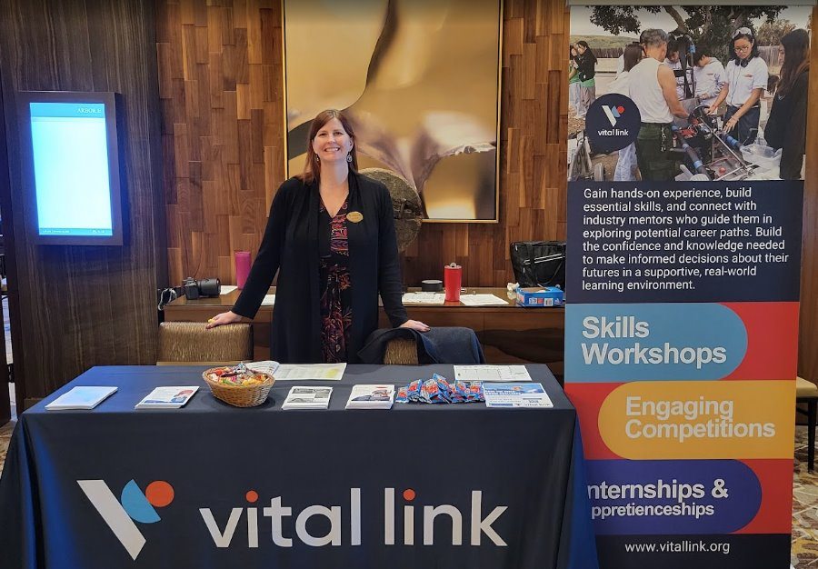
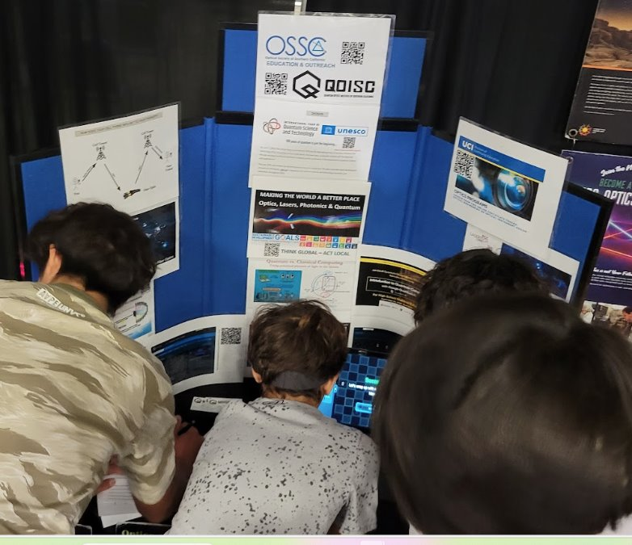
Outreach
“Vital Link is very appreciative for strong industry partners like the Optical Society of Southern California. Over the years the OSSC has provided support for the Vital Link Project Based Learning programs. This assisted Orange County students to prepare for the skills needed in the technology-based workforce.”​
- April Barnes​
President, Vital Link​
To learn more about, or to join the OSSC, please visit our website at www.ossc.org.

Slide 12
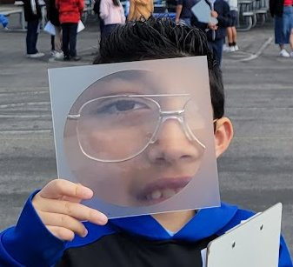
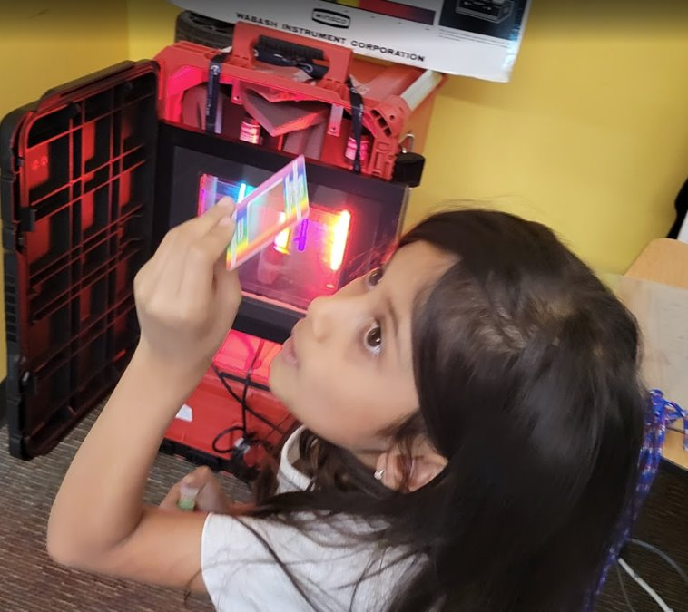
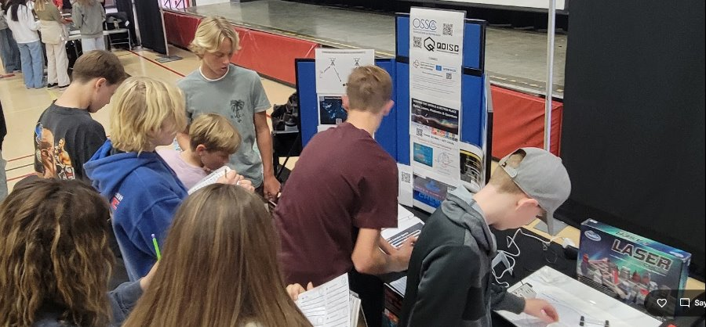
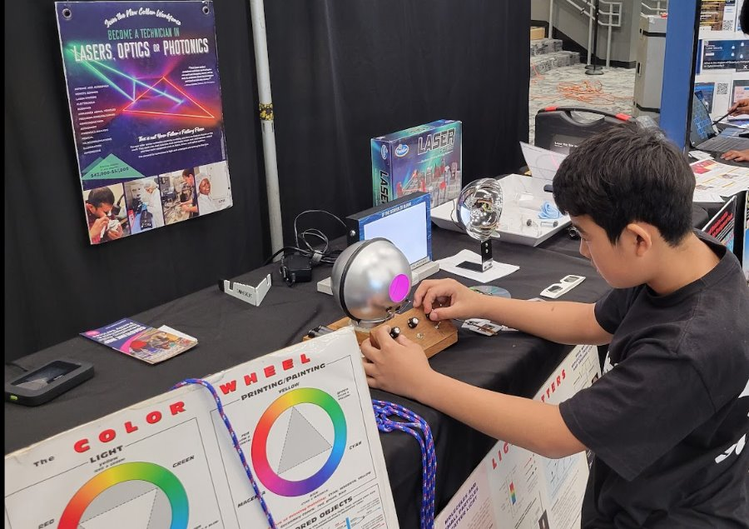
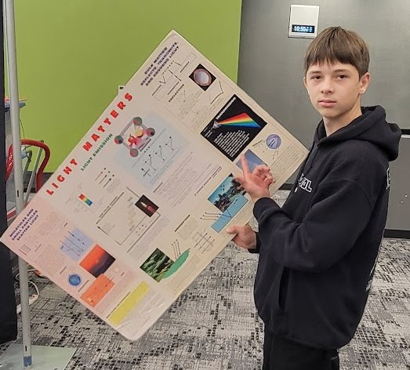
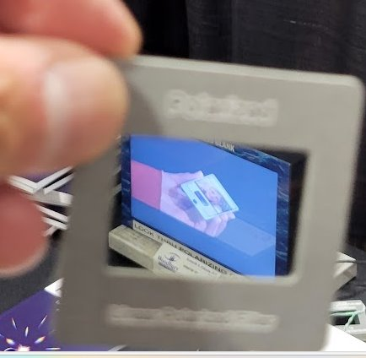
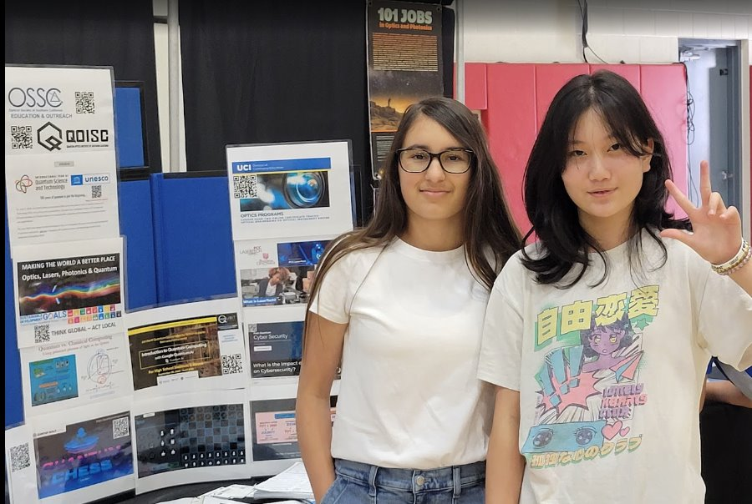
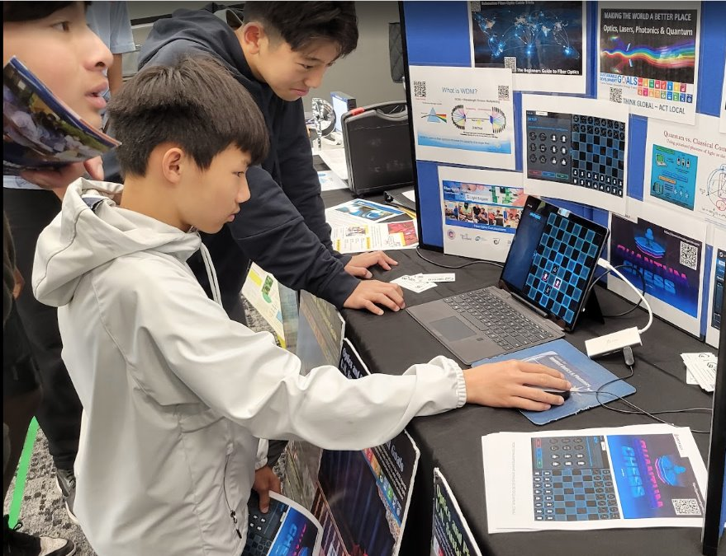
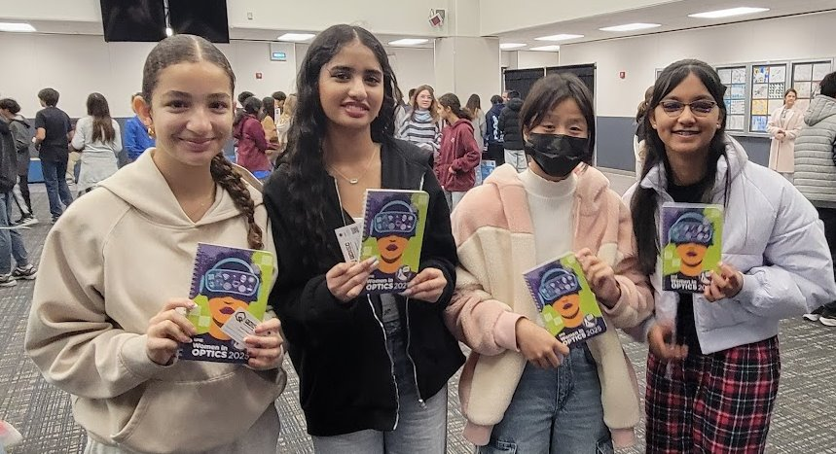
Outreach
To learn more about, or to join the OSSC, please visit our website at www.ossc.org.

Slide 13

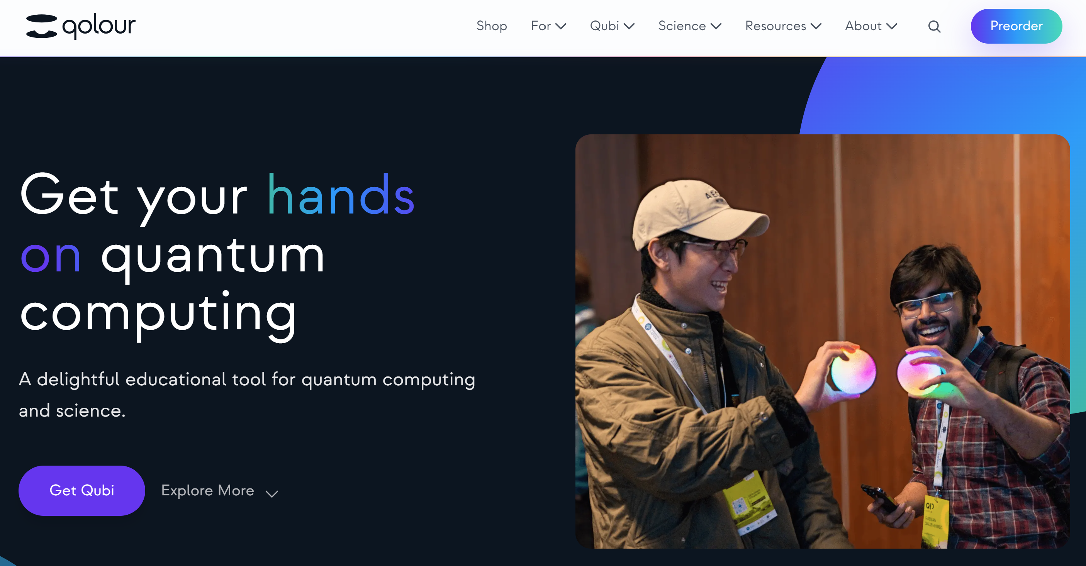
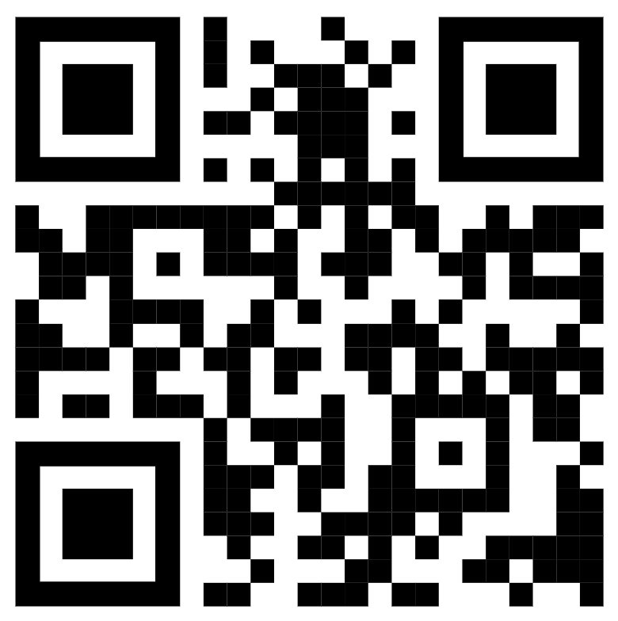
Quantum Education with Qubi by qolour here now in LA, Orange & San Diego Counties

Slide 14

START RECORDING
Time | Event
3:00PM | Reception & Refreshments
3:15PM | Photonics Engineering Lab tours
4:30PM | OSSC + UCSD SPIE business
5:00PM | Speaker Introduction Scaling Lasers & Photonics Technologies From the Lab to the Quantum Market Tim Day, Chairman & CEO, Monarch Quantum
6:00PM | Q&A Session
6:30PM | Meeting Close
To learn more about, or to join the OSSC, please visit our website at www.ossc.org.

Slide 15
Thank you to Our Speaker
Tim Day
Chairman & CEO
Monarch Quantum​
To learn more about, or to join the OSSC, please visit our website at www.ossc.org.

